Slide 1
Azure Big Data Analytics

Slide 2
Intro to data analytics story

Slide 3
Big Data and data warehouse
LOB
CRM
Ingest
Store
Prep & train
Model & serve
BI + Reporting
Graph
Advanced Analytics
Image
Social
Data orchestration and monitoring
Big Data
store
Analytics
engines
Data
warehouse
Real Time Analytics
IoT
Cloud
Azure Data Factory
Azure Blob storage
Azure Data Lake Store
Azure Databricks
Azure HDInsight
Azure Data Lake Analytics
Azure SQL Data Warehouse
Azure Analysis Services

Slide 4

Why we chose NYC taxi data
Publicly available.
Has the scale of a Big data analytics scenario
Represents practical challenges such as disparate data sources, schema changes, skews and biases that customers would face in their own datasets.
Easy to understand
Notes:
Combine 4 and 3

Slide 5


NYC Taxi Dataset
Raw CSV format
1,571,671,152 Trips
Jan 2009 – June 2019
Raw CSV format 76,513,115 Trips Aug 2013 – June 2019
Notes:
Notes:
Data source
https://www1.nyc.gov/site/tlc/about/tlc-trip-record-data.page

Slide 6
Use cases : Business Challenges
Descriptive analytics
Predictive analytics
Prescriptive analytics
Real time Dynamic Views
Notes:
Personas :
Taxi owner (fleet owner)
Waiting (airlines) example ..

Slide 7
Sample business goals
Persona Drivers/taxi operators looking to maximize their fares
Business questions
What is the best time to take a trip for maximum fare ?
Is this a seasonal business ? How does weather affect fares and trips ?
What are the best pick up locations ?
Are longer trips better than shorter trips ?

Slide 8
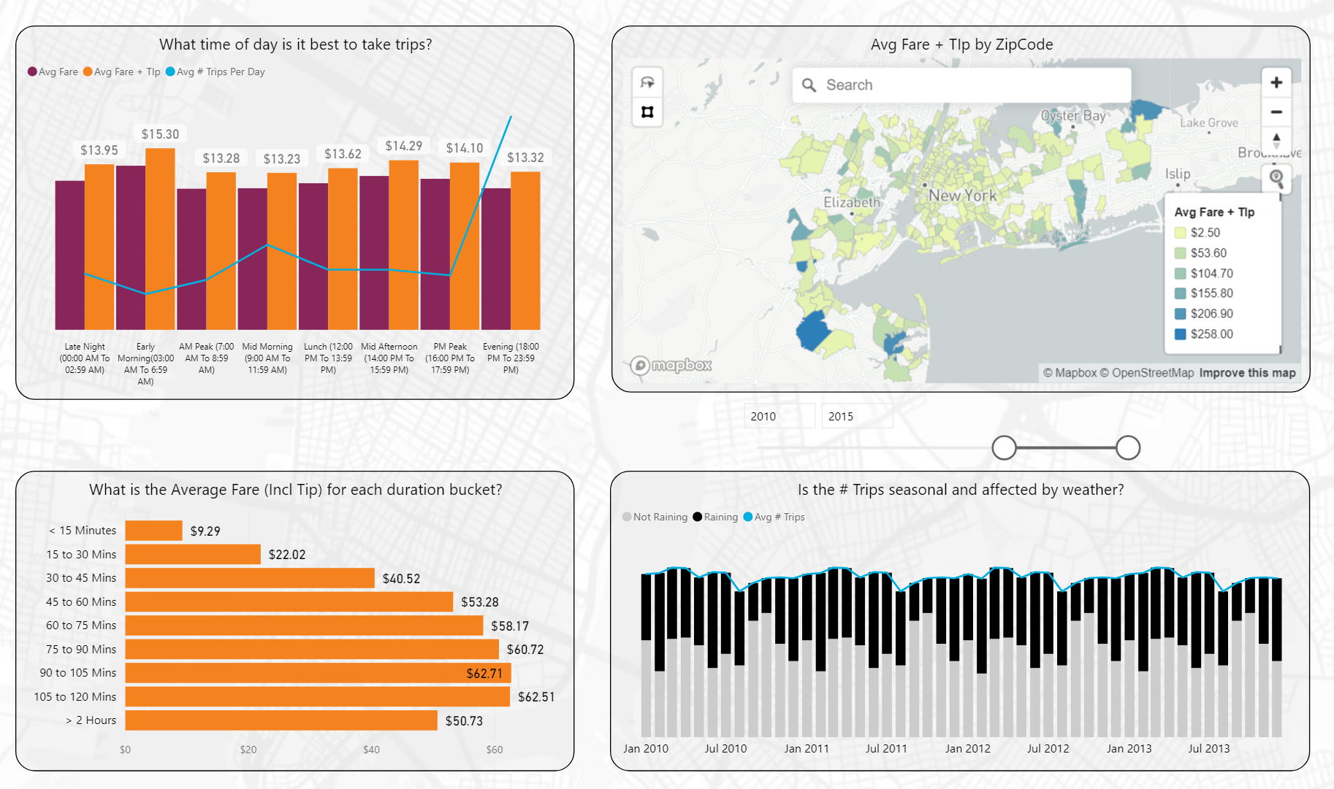

Slide 9
Technical Challenges
Large volume of data
Enumerated data fields
Schema mismatch across taxis
Schema mismatch across years/months
Low latency for dashboards
Notes:
How to ingest

Slide 10




Data transformation
2009 - 2019
Azure
Machine
learning
2013 - 2019
CSV Files
Different Schemas across
Years and months
Materialized view

Slide 11
Data Processing steps
Data Ingestion
Data Loading
Data Transformation
Create Materialized view
Run reports and visualize
Copy and ingest data from the source and store into ADLS Gen2.
Read the CSV and load as Parquet files.
Use data transformation to create a homogenous schema over years and taxi types.
Merge the curated data set to create a single source of truth and convert to delta format
Run queries on the martialized view and create reports to be visualized.
Staging zone
nyctaxi-staging
Raw Zone
nyctaxi-raw-df
Curation zone nyctaxi-curated-df
Consumption zone
nyctaxi-consumption-df
Power BI
Notes:
Kill this

Slide 12


Data Ingestion through Data Factory

Slide 13
Data Source and destination mapping
Source
Destination
https://s3.amazonaws.com/nyc-tlc/trip+data/yellow_tripdata_2016-01.csv
https://s3.amazonaws.com/nyc-tlc/trip+data/green_tripdata_2016-01.csv
https://s3.amazonaws.com/nyc-tlc/trip+data/yellow_tripdata_2016-02.csv
https://s3.amazonaws.com/nyc-tlc/trip+data/green_tripdata_2016-02.csv
…..
…..
https://s3.amazonaws.com/nyc-tlc/trip+data/yellow_tripdata_2016-12.csv
https://s3.amazonaws.com/nyc-tlc/trip+data/green_tripdata_2016-12.csv
https://s3.amazonaws.com/nyc-tlc/trip+data/yellow_tripdata_2017-01.csv
https://s3.amazonaws.com/nyc-tlc/trip+data/green_tripdata_2017-01.csv
https://dbdftest35sa.dfs.core.windows.net/nyctaxi/nyctaxi-staging/transactional-data/type=yellow/year=2016/month=01/yellow_tripdata_2016-01.csv
https://dbdftest35sa.dfs.core.windows.net/nyctaxi/nyctaxi-staging/transactional-data/type=green/year=2016/month=01/green_tripdata_2016-01.csv
https://dbdftest35sa.dfs.core.windows.net/nyctaxi/nyctaxi-staging/transactional-data/type=yellow/year=2016/month=02/green_tripdata_2016-02.csv
https://dbdftest35sa.dfs.core.windows.net/nyctaxi/nyctaxi-staging/transactional-data/type=green/year=2016/month=02/green_tripdata_2016-02.csv
…..
…..
https://dbdftest35sa.dfs.core.windows.net/nyctaxi/nyctaxi-staging/transactional-data/type=yellow/year=2016/month=12/green_tripdata_2016-02.csv
https://dbdftest35sa.dfs.core.windows.net/nyctaxi/nyctaxi-staging/transactional-data/type=green/year=2016/month=12/green_tripdata_2016-02.csv
https://dbdftest35sa.dfs.core.windows.net/nyctaxi/nyctaxi-staging/transactional-data/type=yellow/year=2017/month=01/green_tripdata_2016-02.csv
https://dbdftest35sa.dfs.core.windows.net/nyctaxi/nyctaxi-staging/transactional-data/type=green/year=2017/month=01/green_tripdata_2016-02.csv

Slide 14
Demo
Create a new ADF
Create a new pipe
New dataset
Show sample dataset
Show finished product

Slide 15

Data Loading through Data Factory

Slide 16
Demo
Show data transformation pipeline
Missing columns
Renaming columns

Slide 17
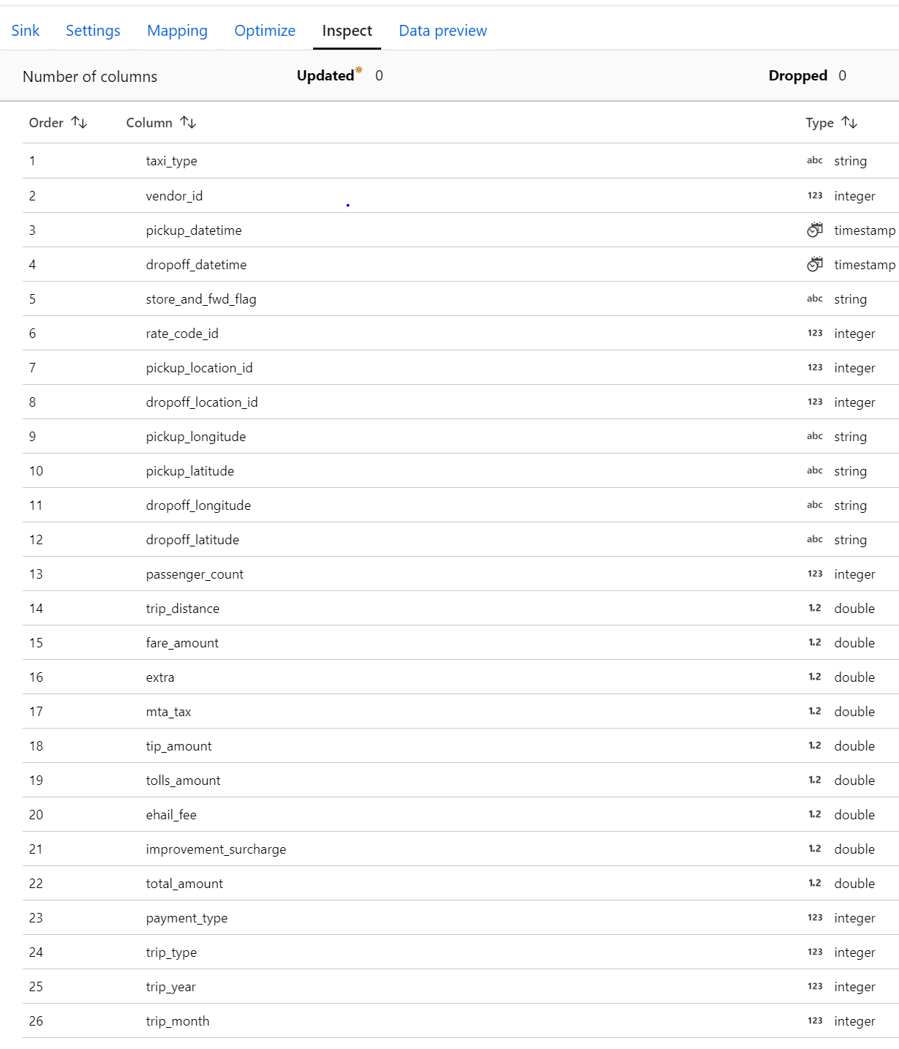
Target Final Schema

Slide 18
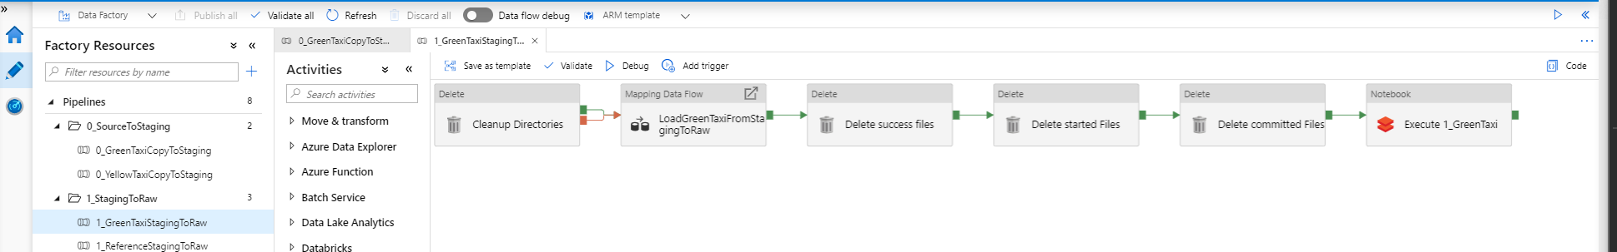
Data Loading Pipeline -- Green Taxi
Initial cleanup
Data transformation and conversion to parquet using Data flow
Create meta store
Cleanup unnecessary files
Staging Zone
Raw Zone
https://dbdftest35sa.dfs.core.windows.net/nyctaxi/nyctaxi-staging/transactional-data/type=yellow/year=2016/month=01/yellow_tripdata_2016-01.csv
https://dbdftest35sa.dfs.core.windows.net/nyctaxi/nyctaxi-raw-df/transactions/yellow-taxi/trip_year=2016/trip_month=1/part-00040-tid-9034811906829313682-12023b1c-bc59-4951-9d18-894acb269b3e-375-1.c000.parquet
…
…
https://dbdftest35sa.dfs.core.windows.net/nyctaxi/nyctaxi-raw-df/transactions/yellow-taxi/trip_year=2016/trip_month=1/part-00247-tid-9034811906829313682-12023b1c-bc59-4951-9d18-894acb269b3e-582-1.c000.parquet

Slide 19
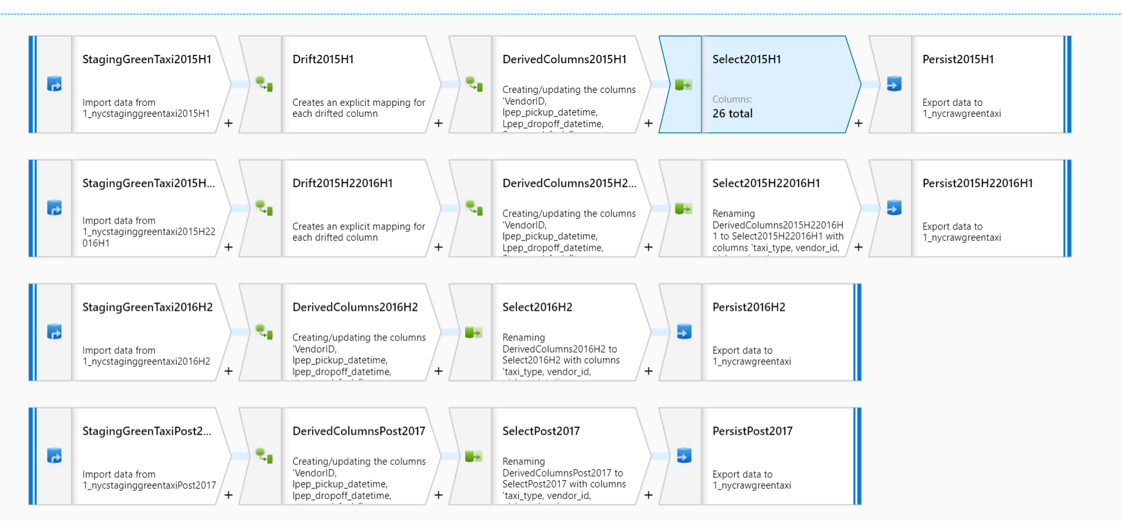
Data Loading Dataflow
Notes:
https://docs.microsoft.com/en-us/azure/data-factory/concepts-data-flow-overview

Slide 20
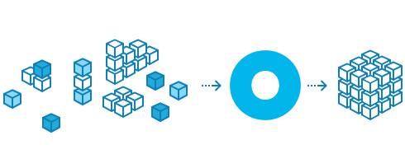
Data Transformation through Data Factory
Notes:
With Data transformation, we would move the Parquet format raw zone to Parquet format in Curated zone. We would merge the reference data look up tables to the master data set so that it has the exact values.

Slide 21
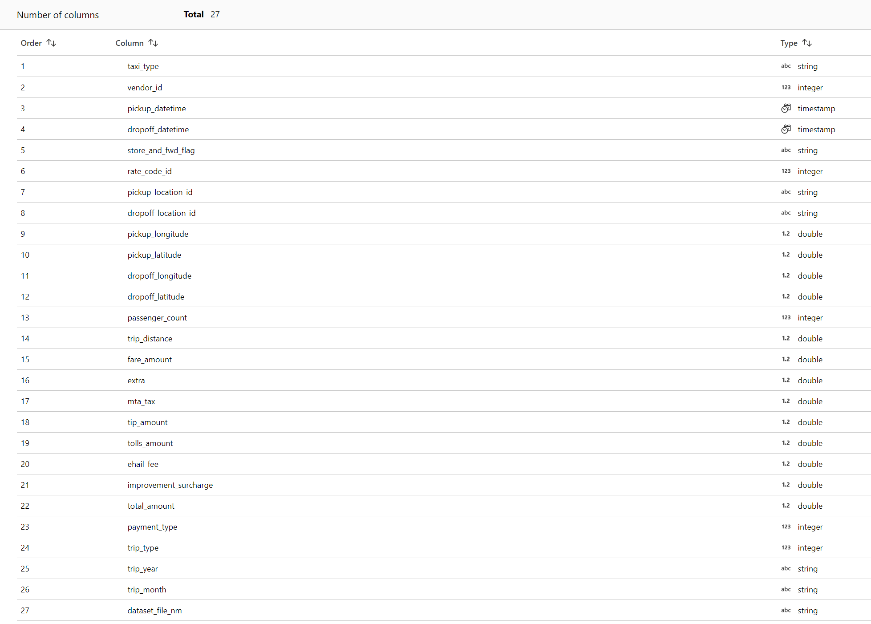
Input Schema

Slide 22
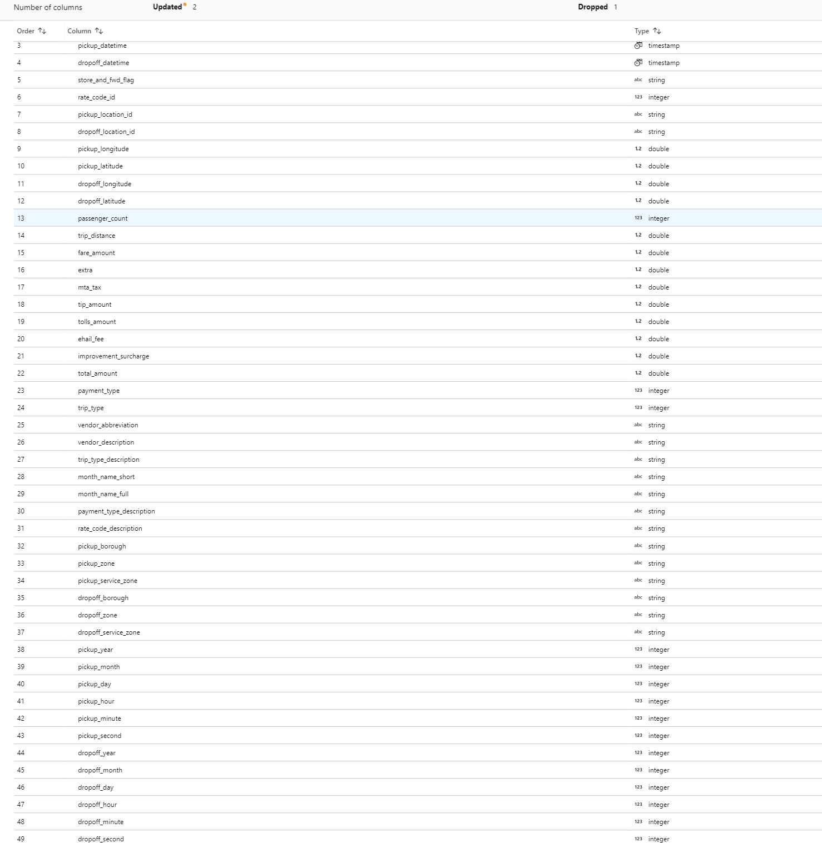
Target Output

Slide 23
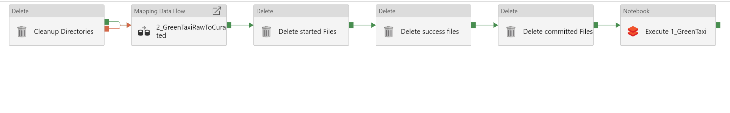
Data Transformation Pipeline
Initial cleanup
Merge Reference Data
Cleanup unnecessary files
Create meta store
Curated Zone
Raw Zone
s://dbdftest35sa.dfs.core.windows.net/nyctaxi/nyctaxi-raw-df/transactions/yellow-taxi/trip_year=2016/trip_month=1/part-00040-tid-9034811906829313682-12023b1c-bc59-4951-9d18-894acb269b3e-375-1.c000.parquet
s://dbdftest35sa.dfs.core.windows.net/nyctaxi/nyctaxi-raw-df/transactions/yellow-taxi/trip_year=2016/trip_month=1/part-00040-tid-9034811906829313682-12023b1c-bc59-4951-9d18-894acb269b3e-375-1.c000.parquet

Slide 24

Machine learning with
consumption data
Notes:
With Data transformation, we would move the Parquet format raw zone to Parquet format in Curated zone. We would merge the reference data look up tables to the master data set so that it has the exact values.

Slide 25
Hands on

Slide 26


Azure Data and AI Platform End to End – Data Factory
Ingest
Store
Prep
Serve
Reporting
Nyc Taxi Dataset ( NYC.gov ) ( Amazon S3 )
Azure Data Factory
Features
Dynamic Pipeline
Lookup
Dynamic Filename & Url
Azure Data Lake Store
Features
Multiple Zones
Staging (Initial Load) (.csv)
Raw (Parquet)
Curated (Parquet)
Consumption (delta lake)
Azure Data Factory
Features
Mapping Dataflows
Dynamic Datasets
Azure Databricks Integration
External Hive metastore
Media (unstructured)
Files (unstructured)
Azure SQL Data Warehouse
Power BI
Business/ custom apps (structured)
Notes:
KIll

